Slide 1
CRYPTOGRAPHY & NETWORK SECURITY Paper Code: ETIT-403
Text Book:
[T1] William Stallings, "Cryptography and Network Security - Principles and Practices", Prentice Hall of India, Third Edition, 2003.
[T2] Wade Trappe, Lawrence C Washington, “Introduction to Cryptography with coding theory”, 2nd ed, Pearson, 2007.
Reference Book:
[R1] R.Rajaram, “Network Security and Cryptography” SciTech Publication, First Edition, 2013.
[R2] Atul Kahate, "Cryptography and Network Security", Tata McGraw-Hill, 2003
[R3] Bruce Schneier, "Applied Cryptography", John Wiley & Sons Inc, 2001.

Slide 2
UNIT- I:
Basic Cryptographic Techniques, Computational Complexity, Finite Fields, Number Theory, DES and AES, Public Key Cryptosystems, Traffic Confidentiality, Cryptanalysis, Intractable (Hard) Problems, Hash Functions, OSI Security Architecture Privacy of Data. [T1, T2] [No. of Hrs: 11]
UNIT- II:
Linear Cryptanalysis, Differential Cryptanalysis, DES, Triple DES, Message Authentication and Digital Signatures, Attacks on Protocols, Elliptic Curve Architecture and Cryptography, Public Key Cryptography and RSA, , Evaluation criteria for AES, Key Management, Authentication requirements Digital forensics including digital evidence handling: Media forensics, Cyber forensics, Software forensics, Mobile forensics. [T1, T2] [No. of Hrs: 11]

Slide 3
Roadmap
Computer Security
Network Security
Mutual Trust
Cryptographic algorithms
symmetric ciphers
asymmetric encryption
hash functions
Notes:
The material in this book is organized into four broad categories:
• Cryptographic algorithms: This is the study of techniques for ensuring the secrecy and/or authenticity of information. The three main areas of study in this category are: 1. symmetric encryption, 2. asymmetric encryption, and 3. cryptographic hash functions, with the related topics of message authentication codes and digital signatures.
• Mutual trust: This is the study of techniques and algorithms for providing mutual trust in two main areas. First, key management and distribution deals with establishing trust in the encryption keys used between two communicating entities. Second, user authentication deals with establish trust in the identity of a communicating partner.
• Network security: This area covers the use of cryptographic algorithms in network protocols and network applications.
• Computer security: In this book, we use this term to refer to the security of computers against intruders (e.g., hackers) and malicious software (e.g., viruses). Typically, the computer to be secured is attached to a network and the bulk of the threats arise from the network.

Slide 4
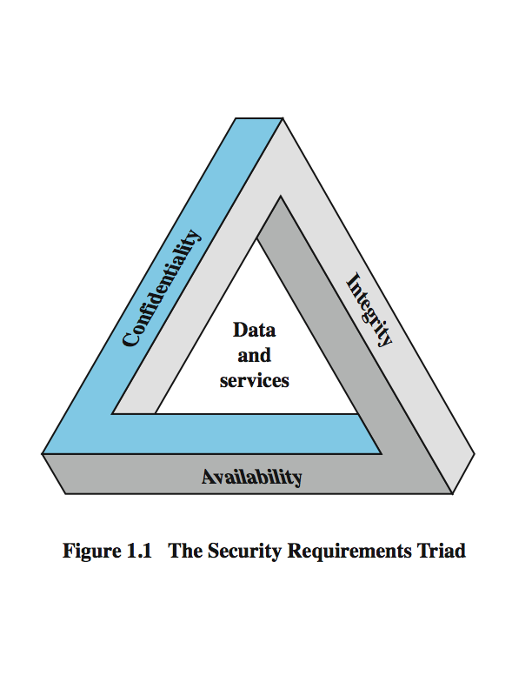
Computer Security
The protection afforded to an automated information system in order to attain the applicable objectives of preserving the integrity, availability and confidentiality of information system resources (includes hardware, software, firmware, information/data, and telecommunications)
Three key objectives that are at the heart of computer security
Notes:
The NIST Computer Security Handbook [NIST95] defines the term computer security as shown on this slide. This definition introduces three key objectives that are at the heart of computer security as we see on the next slide.

Slide 5
Levels of Impact
can define 3 levels of impact from a security breach
Low
Moderate
High
Notes:
We can define three levels of impact on organizations or individuals should there be a breach of security (i.e., a loss of confidentiality, integrity, or availability). These levels are defined in FIPS PUB 199:
• Low: The loss could be expected to have a limited adverse effect on organizational operations, organizational assets, or individuals. A limited adverse effect means that, for example, the loss of confidentiality, integrity, or availability might (i) cause a degradation in mission capability to an extent and duration that the organization is able to perform its primary functions, but the effectiveness of the functions is noticeably reduced; (ii) result in minor damage to organizational assets; (iii) result in minor financial loss; or (iv) result in minor harm to individuals.
• Moderate: The loss could be expected to have a serious adverse effect on organizational operations, organizational assets, or individuals. A serious adverse effect means that, for example, the loss might (i) cause a significant degradation in mission capability to an extent and duration that the organization is able to perform its primary functions, but the effectiveness of the functions is significantly reduced; (ii) result in significant damage to organizational assets; (iii) result in significant financial loss; or (iv) result in significant harm to individuals that does not involve loss of life or serious, life-threatening injuries.
• High: The loss could be expected to have a severe or catastrophic adverse effect on organizational operations, organizational assets, or individuals. A severe or catastrophic adverse effect means that, for example, the loss might (i) cause a severe degradation in or loss of mission capability to an extent and duration that the organization is not able to perform one or more of its primary functions; (ii) result in major damage to organizational assets; (iii) result in major financial loss; or (iv) result in severe or catastrophic harm to individuals involving loss of life or serious life threatening injuries.

Slide 6
Examples of Security Requirements
confidentiality – student grades
integrity – patient information
availability – authentication service
Notes:
We now provide some examples of applications that illustrate the requirements just enumerated.
• Confidentiality - Student grade information is an asset whose confidentiality is considered to be highly important by students. Grade information should only be available to students, their parents, and employees that require the information to do their job. Student enrollment information may have a moderate confidentiality rating. While still coveredby FERPA, this information is seen by more people on a daily basis, is less likely to be targeted than grade information, and results in less damage if disclosed. Directory information, such as lists of students or faculty or departmental lists, may be assigned a low confidentiality rating or indeed no rating. This information is typically freely available to the public and published on a school's Web site.
• Integrity – Consider a hospital patient's allergy information stored in a database. The doctor should be able to trust that the information is correct and current. Now suppose that an employee (e.g., a nurse) who is authorized to view and update this information deliberately falsifies the data to cause harm to the hospital. The database needs to be restored to a trusted basis quickly, and it should be possible to trace the error back to the person responsible. Patient allergy information is an example of an asset with a high requirement for integrity. Inaccurate information could result in serious harm or death to a patient and expose the hospital to massive liability.
• Availability - The more critical a component or service, the higher is the level of availability required. Consider a system that provides authentication services for critical systems, applications, and devices. An interruption of service results in the inability for customers to access computing resources and staff to access the resources they need to perform critical tasks. The loss of the service translates into a large financial loss in lost employee productivity and potential customer loss.

Slide 7
Computer Security Challenges
Not simple
Must consider potential attacks
Procedures used counter-intuitive
Involve algorithms and secret info
Must decide where to deploy mechanisms
Battle of wits between attacker / admin
Not perceived on benefit until fails
Requires regular monitoring
Too often an after-thought
Regarded as impediment to using system
Notes:
Computer security is both fascinating and complex. Some of the reasons follow:
1. Computer security is not as simple as it might first appear to the novice. The requirements seem to be straightforward, but the mechanisms used to meet those requirements can be quite complex and subtle.
2. In developing a particular security mechanism or algorithm, one must always consider potential attacks (often unexpected) on those security features.
3. Hence procedures used to provide particular services are often counterintuitive.
4. Having designed various security mechanisms, it is necessary to decide where to use them.
5. Security mechanisms typically involve more than a particular algorithm or protocol, but also require participants to have secret information, leading to issues of creation, distribution, and protection of that secret information.
6. Computer security is essentially a battle of wits between a perpetrator who tries to find holes and the designer or administrator who tries to close them.
7. There is a natural tendency on the part of users and system managers to perceive little benefit from security investment until a security failure occurs.
8. Security requires regular monitoring, difficult in today's short-term environment.
9. Security is still too often an afterthought - incorporated after the design is complete.
10. Many users / security administrators view strong security as an impediment to efficient and user-friendly operation of an information system or use of information.

Slide 8
OSI(Open Systems Interconnection) Security Architecture
ITU-T X.800 (International Telecommunication Union Telecommunication Standardization Sector) “Security Architecture for OSI”
Defines a systematic way of defining and providing security requirements
It provides a useful, abstract, overview of concepts we will study
Notes:
To assess effectively the security needs of an organization and to evaluate and choose various security products and policies, the manager responsible for security needs some systematic way of defining the requirements for security and characterizing the approaches to satisfying those requirements. This is difficult enough in a centralized data processing environment; with the use of local and wide area networks the problems are compounded. ITU-T Recommendation X.800, Security Architecture for OSI, defines such a systematic approach. The OSI security architecture is useful to managers as a way of organizing the task of providing security.

Slide 9
Aspects of Security
Consider Three aspects of information security:
Security attack
Security mechanism
Security service
Important terms
Threat – a potential for violation of security
Attack – an assault on system security, a deliberate attempt to evade security services
Notes:
The OSI security architecture focuses on security attacks, mechanisms, and services. These can be defined briefly as follows:
• Security attack: Any action that compromises the security of information owned by an organization.
• Security mechanism: A process (or a device incorporating such a process) that is designed to detect, prevent, or recover from a security attack.
• Security service: A processing or communication service that enhances the security of the data processing systems and the information transfers of an organization. The services are intended to counter security attacks, and they make use of one or more security mechanisms to provide the service.
In the literature, the terms threat and attack are commonly used to mean more or less the same thing. Table 1.1 provides definitions taken from RFC 2828, Internet Security Glossary.
Threat - A potential for violation of security, which exists when there is a circumstance, capability, action, or event that could breach security and cause harm. That is, a threat is a possible danger that might exploit a vulnerability.
Attack - An assault on system security that derives from an intelligent threat; that is, an intelligent act that is a deliberate attempt (especially in the sense of a method or technique) to evade security services and violate the security policy of a system.

Slide 10
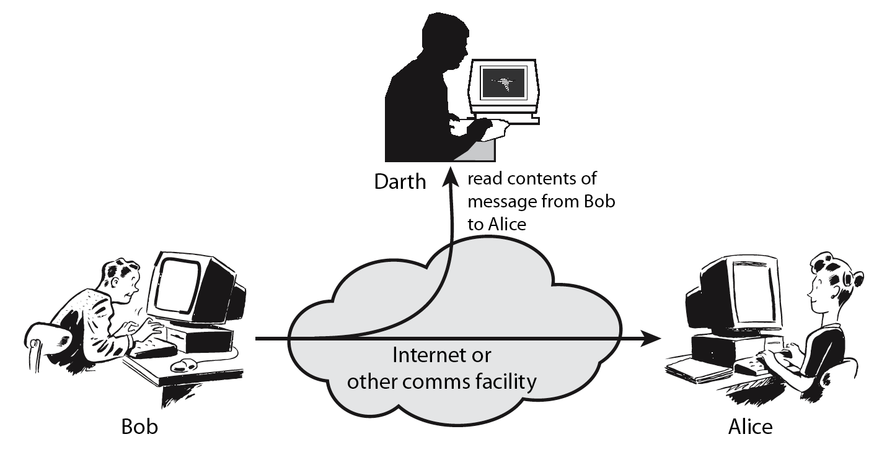
Passive Attacks
Notes:
A useful means of classifying security attacks, used both in X.800 and RFC 2828, is in terms of passive attacks and active attacks. A passive attack attempts to learn or make use of information from the system but does not affect system resources.
Passive attacks are in the nature of eavesdropping on, or monitoring of, transmissions. The goal of the opponent is to obtain information that is being transmitted. Two types of passive attacks are:
+ release of message contents - as shown above in Stallings Figure 1.2a here
+ traffic analysis - monitor traffic flow to determine location and identity of communicating hosts and could observe the frequency and length of messages being exchanged
These attacks are difficult to detect because they do not involve any alteration of the data.

Slide 11
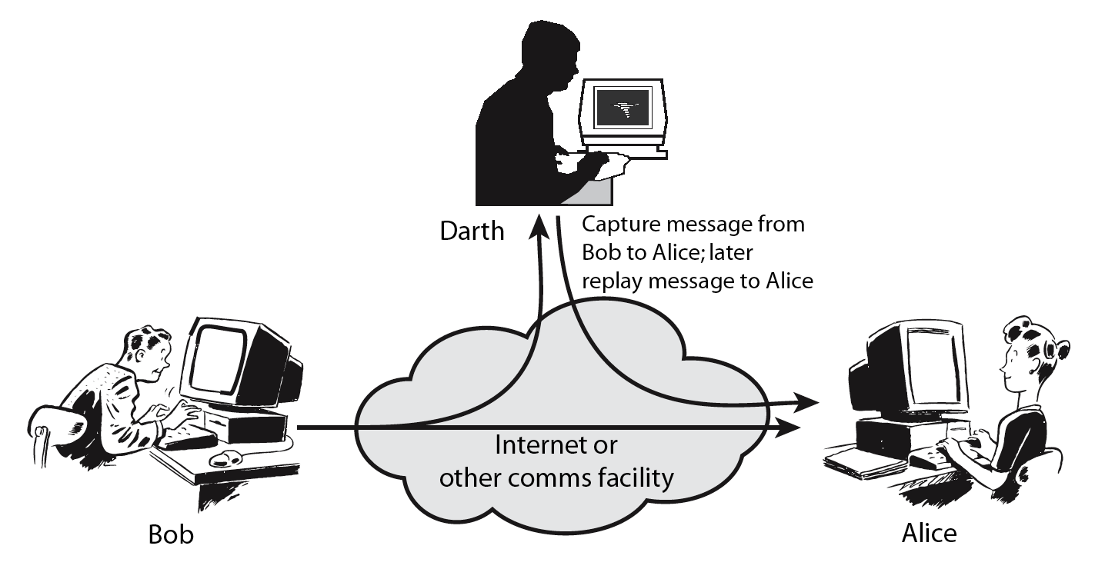
Active Attacks
Notes:
Active attacks involve some modification of the data stream or the creation of a false stream and can be subdivided into four categories: masquerade, replay, modification of messages, and denial of service:
masquerade of one entity as some other
replay previous messages (as shown above in Stallings Figure 1.3b)
modify/alter (part of) messages in transit to produce an unauthorized effect
denial of service - prevents or inhibits the normal use or management of communications facilities
Active attacks present the opposite characteristics of passive attacks. Whereas passive attacks are difficult to detect, measures are available to prevent their success. On the other hand, it is quite difficult to prevent active attacks absolutely, because of the wide variety of potential physical, software, and network vulnerabilities. Instead, the goal is to detect active attacks and to recover from any disruption or delays caused by them.

Slide 12
Security Service
Enhance security of data processing systems and information transfers of an organization
Intended to counter security attacks
Using one or more security mechanisms
Often replicates functions normally associated with physical documents
which, for example, have signatures, dates; need protection from disclosure, tampering, or destruction; be notarized or witnessed; be recorded or licensed
Notes:
Consider the role of a security service, and what may be required.
Note both similarities and differences with traditional paper documents, which for example:
have signatures & dates;
need protection from disclosure, tampering, or destruction;
may be notarized or witnessed;
may be recorded or licensed

Slide 13
Security Services
X.800:
“ A service provided by a protocol layer of communicating open systems, which ensures adequate security of the systems or of data transfers”.
RFC 2828:
“ A processing or communication service provided by a system to give a specific kind of protection to system resources”.
Notes:
State here a couple of definitions of “security services” from relevant standards. X.800 defines a security service as a service provided by a protocol layer of communicating open systems, which ensures adequate security of the systems or of data transfers. Perhaps a clearer definition is found in RFC 2828, which provides the following definition: a processing or communication service that is provided by a system to give a specific kind of protection to system resources; security services implement security policies and are implemented by security mechanisms.

Slide 14
Security Services (X.800)
Authentication - assurance that communicating entity is the one claimed
have both peer-entity & data origin authentication
Access Control - prevention of the unauthorized use of a resource
Data Confidentiality – protection of data from unauthorized disclosure
Data Integrity - assurance that data received is as sent by an authorized entity
Non-Repudiation - protection against denial by one of the parties in a communication
Availability – resource accessible/usable
Notes:
This list is taken from Stallings Table 1.2 which provides details of the 5 Security Service categories and the 14 specific services given in X.800.
This list includes the various "classic" security services which are traditionally discussed. Note there is a degree of ambiguity as to the meaning of these terms, and overlap in their use. The broad service categories are:
authentication is concerned with assuring that a communication is authentic. Two specific authentication services are defined in X.800: Peer entity authentication: provides corroboration of the identity of a peer entity in an association; and Data origin authentication: provides corroboration of the source of a data unit.
access control is the ability to limit and control the access to host systems and applications via communications links.
confidentiality is the protection of transmitted data from passive attacks, and the protection of traffic flow from analysis.
integrity assures that messages are received as sent, with no duplication, insertion, modification, reordering, replay, or loss.
availability is the property of a system / resource being accessible and usable upon demand by an authorized system entity, according to performance specifications for the system.

Slide 15
Security Mechanisms (X.800)
Specific security mechanisms:
encipherment, digital signatures, access controls, data integrity, authentication exchange, traffic padding, routing control, notarization
Pervasive security mechanisms:
trusted functionality, security labels, event detection, security audit trails, security recovery
Notes:
Some examples of mechanisms from X.800. Note that the “specific security mechanisms” are protocol layer specific, whilst the “pervasive security mechanisms” are not. We will meet some of these mechanisms in much greater detail later.
See Stallings Table 1.3 for details of these mechanisms in X.800, and Table 1.4 for the relationship between services and mechanisms.

Slide 16
Security Mechanism
Feature designed to detect, prevent, or recover from a security attack
No single mechanism that will support all services required
However one particular element underlies many of the security mechanisms in use:
cryptographic techniques
Notes:
Now introduce “Security Mechanism” which are the specific means of implementing one or more security services. Note these mechanisms span a wide range of technical components, but one aspect seen in many is the use of cryptographic techniques.

Slide 17
Network Security
Network and Internet security consists of measures to deter, prevent, detect, and correct security violations that involve the transmission of information.
Example
A network manager, D, transmits a message to a computer, E, under its management. The message instructs computer E to update an authorization file to include the identities of a number of new users who are to be given access to that computer. User F intercepts the message, alters its contents to add or delete entries, and then forwards the message to computer E, which accepts the message as coming from manager D and updates its authorization file accordingly.
Notes:
The NIST Computer Security Handbook [NIST95] defines the term computer security as shown on this slide. This definition introduces three key objectives that are at the heart of computer security as we see on the next slide.

Slide 18
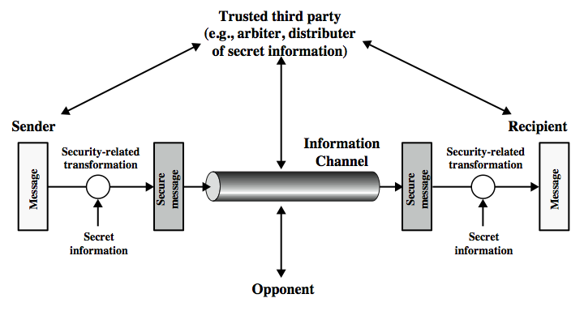
Model for Network Security
Notes:
In considering the place of encryption, its useful to use the following two models from Stallings section 1.6.
The first, illustrated in Figure 1.4, models information being transferred from one party to another over an insecure communications channel, in the presence of possible opponents. The two parties, who are the principals in this transaction, must cooperate for the exchange to take place. They can use an appropriate security transform (encryption algorithm), with suitable keys, possibly negotiated using the presence of a trusted third party. Parts One through Four of this book concentrates on the types of security mechanisms and services that fit into the model shown here.

Slide 19
Model for Network Security
Using this model we are require to:
Design a suitable algorithm for the security transformation.
2. Generate the secret information (keys) used by the algorithm.
Develop methods to distribute and share the secret information.
Specify a protocol enabling the principals to use the transformation and secret information for a security service.
Notes:
This general model shows that there are four basic tasks in designing a particular security service, as listed.

Slide 20
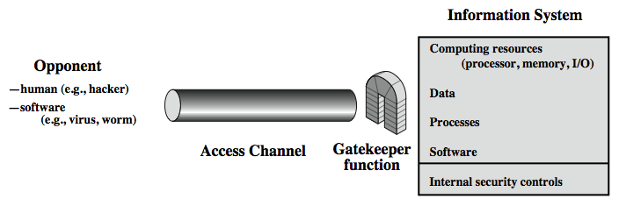
Model for Network Access Security
Notes:
The second, illustrated in Figure 1.5, model is concerned with controlled access to information or resources on a computer system, in the presence of possible opponents. Here appropriate controls are needed on the access to and within the system, to provide suitable security.
The security mechanisms needed to cope with unwanted access fall into two broad categories (as shown in this figure). The first category might be termed a gatekeeper function. It includes password-based login procedures that are designed to deny access to all but authorized users and screening logic that is designed to detect and reject worms, viruses, and other similar attacks. Once either an unwanted user or unwanted software gains access, the second line of defense consists of a variety of internal controls that monitor activity and analyze stored information in an attempt to detect the presence of unwanted intruders. These issues are explored in Part Four.

Slide 21
Model for Network Access Security
using this model we are require to:
Select appropriate gatekeeper functions to identify users.
Implement security controls to ensure only authorised users
access designated information or resources.
Notes:
Detail here the tasks needed to use this model.

Slide 22
What Is Cryptography?
Cryptography -- from the Greek for “secret writing” -- is the mathematical “scrambling” of data so that only someone with the necessary key can “unscramble” it.
Cryptography allows secure transmission of private information over insecure channels (for example packet-switched networks).
Cryptography also allows secure storage of sensitive data on any computer.
Notes:
Computers can very quickly search a document for a specified phrase (e.g., "Top secret" or "Social Security Number")

Slide 23
Some Basic Terminology
plaintext - original message
ciphertext - coded message
cipher - algorithm for transforming plaintext to ciphertext
key - info used in cipher known only to sender/receiver
encipher (encrypt) - converting plaintext to ciphertext
decipher (decrypt) - recovering ciphertext from plaintext
cryptography - study of encryption principles/methods
cryptanalysis (codebreaking) - study of principles/ methods of deciphering ciphertext without knowing key
cryptology - field of both cryptography and cryptanalysis
Notes:
Briefly review some terminology used throughout the course.

Slide 24
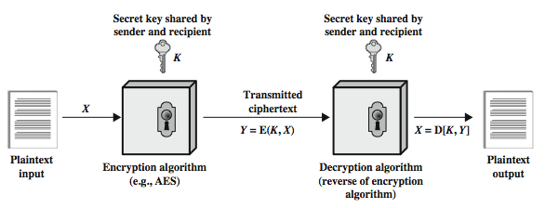
Symmetric Cipher Model
Notes:
Detail the five ingredients of the symmetric cipher model, shown in Stallings Figure 2.1:
plaintext - original message
encryption algorithm – performs substitutions/transformations on plaintext
secret key – control exact substitutions/transformations used in encryption algorithm
ciphertext - scrambled message
decryption algorithm – inverse of encryption algorithm

Slide 25
Requirements
Two requirements for secure use of symmetric encryption:
a strong encryption algorithm
a secret key known only to sender / receiver
Mathematically have:
Y = E(K, X)
X = D(K, Y)
Assume encryption algorithm is known
Implies a secure channel to distribute key
Notes:
There are two requirements for secure use of conventional encryption that mean we assume that it is impractical to decrypt a message on the basis of the cipher- text plus knowledge of the encryption/decryption algorithm, and hence do not need to keep the algorithm secret; rather we only need to keep the key secret. This feature of symmetric encryption is what makes it feasible for widespread use. It allows easy distribution of s/w and h/w implementations.
Can take a closer look at the essential elements of a symmetric encryption scheme: mathematically it can be considered a pair of functions with: plaintext X, ciphertext Y, key K, encryption algorithm E, decryption algorithm D. The intended receiver, in possession of the key, is able to invert the transformation. An opponent, observing Y but not having access to K or X, may attempt to recover X or K.

Slide 26
Cryptography
Can characterize cryptographic system by:
type of encryption operations used
substitution
transposition
product
number of keys used
single-key or private
two-key or public
way in which plaintext is processed
block
stream
Notes:
Cryptographic systems can be characterized along these three independent dimensions.
The type of operations used for transforming plaintext to ciphertext. All encryption algorithms are based on two general principles: substitution, in which each element in the plaintext (bit, letter, group of bits or letters) is mapped into another element, and transposition, in which elements in the plaintext are rearranged. The fundamental requirement is that no information be lost (that is, that all operations are reversible). Most systems, referred to as product systems, involve multiple stages of substitutions and transpositions.
The number of keys used. If both sender and receiver use the same key, the system is referred to as symmetric, single-key, secret-key, or conventional encryption. If the sender and receiver use different keys, the system is referred to as asymmetric, two-key, or public-key encryption.
The way in which the plaintext is processed. A block cipher processes the input one block of elements at a time, producing an output block for each input block. A stream cipher processes the input elements continuously, producing output one element at a time, as it goes along.

Slide 27
Cryptanalysis
Objective to recover key not just message
General approaches:
cryptanalytic attack
brute-force attack
If either succeed all key use compromised
Notes:
Typically objective is to recover the key in use rather then simply to recover the plaintext of a single ciphertext. There are two general approaches:
Cryptanalysis: relies on the nature of the algorithm plus perhaps some knowledge of the general characteristics of the plaintext or even some sample plaintext- ciphertext pairs. This type of attack exploits the characteristics of the algorithm to attempt to deduce a specific plaintext or to deduce the key being used.
Brute-force attacks try every possible key on a piece of ciphertext until an intelligible translation into plaintext is obtained. On average,half of all possible keys must be tried to achieve success.
If either type of attack succeeds in deducing the key, the effect is catastrophic: All future and past messages encrypted with that key are compromised.

Slide 28
Cryptanalytic Attacks
ciphertext only
only know algorithm & ciphertext, is statistical, know or can identify plaintext
known plaintext
know/suspect plaintext & ciphertext
chosen plaintext
select plaintext and obtain ciphertext
chosen ciphertext
select ciphertext and obtain plaintext
chosen text
select plaintext or ciphertext to en/decrypt
Notes:
Stallings Table 2.1 summarizes the various types of cryptanalytic attacks, based on the amount of information known to the cryptanalyst, from least to most. The most difficult problem is presented when all that is available is the ciphertext only. In some cases, not even the encryption algorithm is known, but in general we can assume that the opponent does know the algorithm used for encryption. Then with increasing information have the other attacks. Generally, an encryption algorithm is designed to withstand a known-plaintext attack.

Slide 29
More Definitions
unconditional security
no matter how much computer power or time is available, the cipher cannot be broken since the ciphertext provides insufficient information to uniquely determine the corresponding plaintext
computational security
given limited computing resources (eg time needed for calculations is greater than age of universe), the cipher cannot be broken
Notes:
Two more definitions are worthy of note. An encryption scheme is unconditionally secure if the ciphertext generated by the scheme does not contain enough information to determine uniquely the corresponding plaintext, no matter how much ciphertext is available. An encryption scheme is said to be computationally secure if either the cost of breaking the cipher exceeds the value of the encrypted information, or the time required to break the cipher exceeds the useful lifetime of the information. Unconditional security would be nice, but the only known such cipher is the one-time pad (later).
For all reasonable encryption algorithms, we have to assume computational security where it either takes too long, or is too expensive, to bother breaking the cipher.

Slide 30
Brute Force Search
Always possible to simply try every key
Most basic attack, proportional to key size
Assume either know / recognise plaintext
Key Size (bits) | Number of Alternative Keys | Time required at 1 decryption/µs | Time required at 10⁶ decryptions/µs
32 | 2³² = 4.3 × 10⁹ | 2³¹ µs = 35.8 minutes | 2.15 milliseconds
56 | 2⁵⁶ = 7.2 × 10¹⁶ | 2⁵⁵ µs = 1142 years | 10.01 hours
128 | 2¹²⁸ = 3.4 × 10³⁸ | 2¹²⁷ µs = 5.4 × 10²⁴ years | 5.4 × 10¹⁸ years
168 | 2¹⁶⁸ = 3.7 × 10⁵⁰ | 2¹⁶⁷ µs = 5.9 × 10³⁶ years | 5.9 × 10³⁰ years
26 characters (permutation) | 26! = 4 × 10²⁶ | 2 × 10²⁶ µs = 6.4 × 10¹² years | 6.4 × 10⁶ years
Notes:
A brute-force attack involves trying every possible key until an intelligible translation of the ciphertext into plaintext is obtained. On average, half of all possible keys must be tried to achieve success. Stallings Table 2.2 shows how much time is required to conduct a brute-force attack, for various common key sizes (DES is 56, AES is 128, Triple-DES is 168, plus general mono-alphabetic cipher), where either a single system or a million parallel systems, are used.

Slide 31
Caesar Cipher
Earliest known substitution cipher
By Julius Caesar
First attested use in military affairs
Replaces each letter by 3rd letter on
Example:
meet me after the party
PHHW PH DIWHU WKH SDUWB
Notes:
Substitution ciphers form the first of the fundamental building blocks. The core idea is to replace one basic unit (letter/byte) with another. Whilst the early Greeks described several substitution ciphers, the first attested use in military affairs of one was by Julius Caesar, described by him in Gallic Wars (cf. Kahn pp83-84). Still call any cipher using a simple letter shift a caesar cipher, not just those with shift 3.

Slide 32
Caesar Cipher
Can define transformation as:
a b c d e f g h i j k l m n o p q r s t u v w x y z
D E F G H I J K L M N O P Q R S T U V W X Y Z A B C
Mathematically give each letter a number
a b c d e f g h i j k l m n o p q r s t u v w x y z
0 1 2 3 4 5 6 7 8 9 10 11 12 13 14 15 16 17 18 19 20 21 22 23 24 25
Then have Caesar cipher as:
c = E(k, p) = (p + k) mod (26)
p = D(k, c) = (c – k) mod (26)
Notes:
This mathematical description uses modulo (clock) arithmetic. Here, when you reach Z you go back to A and start again. Mod 26 implies that when you reach 26, you use 0 instead (ie the letter after Z, or 25 + 1 goes to A or 0).
Example: howdy (7,14,22,3,24) encrypted using key f (ie a shift of 5) is MTBID

Slide 33
Cryptanalysis of Caesar Cipher
Only have 26 possible ciphers
A maps to A,B,..Z
Could simply try each in turn
A brute force search
Given ciphertext, just try all shifts of letters
Do need to recognize when have plaintext
eg. break ciphertext "GCUA VQ DTGCM“
easy to break
Notes:
With a caesar cipher, there are only 26 possible keys, of which only 25 are of any use, since mapping A to A etc doesn't really obscure the message! Note this basic rule of cryptanalysis "check to ensure the cipher operator hasn't goofed and sent a plaintext message by mistake"!
Can try each of the keys (shifts) in turn, until can recognise the original message. See Stallings Fig 2.3 for example of search.
Note: as mentioned before, do need to be able to recognise when have an original message (ie is it English or whatever). Usually easy for humans, hard for computers. Though if using say compressed data could be much harder.
Example "GCUA VQ DTGCM" when broken gives "easy to break", with a shift of 2 (key C).

Slide 34
Monoalphabetic Cipher
Rather than just shifting the alphabet
Could shuffle (jumble) the letters arbitrarily
Each plaintext letter maps to a different random ciphertext letter
Hence key is 26 letters long
Plain: abcdefghijklmnopqrstuvwxyz
Cipher: DKVQFIBJWPESCXHTMYAUOLRGZN
Plaintext: ifwewishtoreplaceletters
Ciphertext: WIRFRWAJUHYFTSDVFSFUUFYA
Notes:
With only 25 possible keys, the Caesar cipher is far from secure. A dramatic increase in the key space can be achieved by allowing an arbitrary substitution, where the translation alphabet can be any permutation of the 26 alphabetic characters. A permutation of a finite set of elements S is an ordered sequence of all the elements of S, with each element appearing exactly once. In general, there are n! permutations of a set of n elements.
See text example of a translation alphabet, and an encrypted message using it.

Slide 35
Monoalphabetic Cipher Security
Now have a total of 26! = 4 x 10²⁶ keys
With so many keys, might think is secure
But would be !!!WRONG!!!
Problem is language characteristics
Notes:
Note that even given the very large number of keys, being 10 orders of magnitude greater than the key space for DES, the monoalphabetic substitution cipher is not secure, because it does not sufficiently obscure the underlying language characteristics.

Slide 36
Language Redundancy and Cryptanalysis
human languages are redundant
eg "th lrd s m shphrd shll nt wnt"
letters are not equally commonly used
in English E is by far the most common letter
followed by T,R,N,I,O,A,S
other letters like Z,J,K,Q,X are fairly rare
have tables of single, double & triple letter frequencies for various languages
Notes:
As the example shows, we don't actually need all the letters in order to understand written English text. Here vowels were removed, but they're not the only redundancy. cf written Hebrew has no vowels for same reason. Are usually familiar with "party conversations", can hear one person speaking out of hubbub of many, again because of redundancy in aural language also. This redundancy is also the reason we can compress text files, the computer can derive a more compact encoding without losing any information. Basic idea is to count the relative frequencies of letters, and note the resulting pattern.

Slide 37
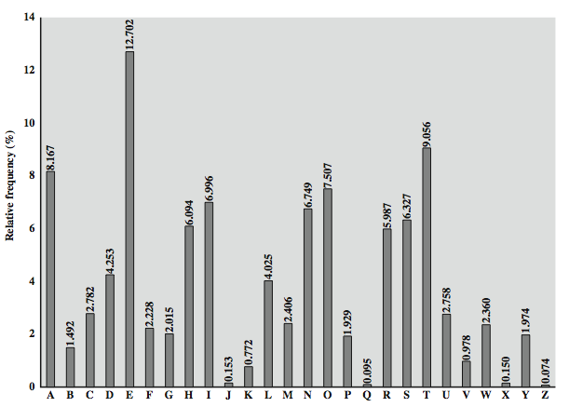
English Letter Frequencies
Notes:
Note that all human languages have varying letter frequencies, though the number of letters and their frequencies varies. Stallings Figure 2.5 shows English letter frequencies. Seberry & Pieprzyk, "Cryptography - An Introduction to Computer Security", Prentice-Hall 1989, Appendix A has letter frequency graphs for 20 languages (most European & Japanese & Malay). Also useful are tables of common two-letter combinations, known as digrams, and three-letter combinations, known as trigrams.

Slide 38
Use in Cryptanalysis
key concept - monoalphabetic substitution ciphers do not change relative letter frequencies
discovered by Arabian scientists in 9th century
calculate letter frequencies for ciphertext
compare counts/plots against known values
if caesar cipher look for common peaks/troughs
peaks at: A-E-I triple, NO pair, RST triple
troughs at: JK, X-Z
for monoalphabetic must identify each letter
tables of common double/triple letters help
Notes:
The simplicity and strength of the monoalphabetic substitution cipher meant it dominated cryptographic use for the first millenium AD. It was broken by Arabic scientists. The earliest known description is in Abu al-Kindi's "A Manuscript on Deciphering Cryptographic Messages", published in the 9th century but only rediscovered in 1987 in Istanbul, but other later works also attest to their knowledge of the field. Monoalphabetic ciphers are easy to break because they reflect the frequency data of the original alphabet. The cryptanalyst looks for a mapping between the observed pattern in the ciphertext, and the known source language letter frequencies. If English, look for peaks at: A-E-I triple, NO pair, RST triple, and troughs at: JK, X-Z.
Monoalphabetic ciphers are easy to break because they reflect the frequency data of the original alphabet.

Slide 39
Example Cryptanalysis
given ciphertext:
UZQSOVUOHXMOPVGPOZPEVSGZWSZOPFPESXUD
BMETSXAIZ
VUEPHZHMDZSHZOWSFPAPPDTSVPQUZWYMXUZUHSX
EPYEPOPDZSZUFPOMBZWPFUPZHMDJUDTMOHMQ
count relative letter frequencies
A-2, B-2,C-0,D-6,E-6,F-4,G-2,H-7,I-1,J-1,K-0,L-0,M-8,N-0,O-9,P-16,Q-3,R-0,S-10,T-3,U-10,V-5,
W-4,X-5,Y-2,Z-15
guess P & Z are e and t
guess ZW is th and hence ZWP is the
proceeding with trial and error finally get:
it was disclosed yesterday that several informal but
direct contacts have been made with political
representatives of the viet cong in moscow
Notes:
Illustrate the process with this example from the text in Stallings section 2.2. Comparing letter frequency breakdown with Figure 2.5, it seems likely that cipher letters P and Z are the equivalents of plain letters e and t, but it is not certain which is which. The letters S, U, O, M, and H are all of relatively high frequency and probably correspond to plain letters from the set {a, h, i, n, o, r, s}. The letters with the lowest frequencies (namely, A, B, G, Y, I, J) are likely included in the set {b, j, k, q, v, x, z}. A powerful tool is to look at the frequency of two-letter combinations, known as digrams. A table similar to Figure 2.5 could be drawn up showing the relative frequency of digrams. The most common such digram is th. In our ciphertext, the most common digram is ZW, which appears three times. So we make the correspondence of Z with t and W with h. Then, by our earlier hypothesis, we can equate P with e. Now notice that the sequence ZWP appears in the ciphertext, and we can translate that sequence as "the." This is the most frequent trigram (three- letter combination) in English, which seems to indicate that we are on the right track. Next, notice the sequence ZWSZ in the first line. We do not know that these four letters form a complete word, but if they do, it is of the form th_t. If so, S equates with a. Only four letters have been identified, but already we have quite a bit of the message. Continued analysis of frequencies plus trial and error should easily yield a solution from this point. The complete plaintext, with spaces added between words, is shown on slide.

Slide 40
Playfair Cipher
not even the large number of keys in a monoalphabetic cipher provides security
one approach to improving security was to encrypt multiple letters
the Playfair Cipher is an example
invented by Charles Wheatstone in 1854, but named after his friend Baron Playfair
Notes:
Consider ways to reduce the "spikyness" of natural language text, since if just map one letter always to another, the frequency distribution is just shuffled. One approach is to encrypt more than one letter at once. The Playfair cipher is an example of doing this, treats digrams in the plaintext as single units and translates these units into ciphertext digrams.

Slide 41
Playfair Key Matrix
a 5X5 matrix of letters based on a keyword
fill in letters of keyword (minus duplicates) from left to right and top to bottom
fill rest of matrix with other letters in alphabetic order.
Letter i/j count as one letter.
eg. using the keyword MONARCHY
M | O | N | A | R
C | H | Y | B | D
E | F | G | I/J | K
L | P | Q | S | T
U | V | W | X | Z
Notes:
The best-known multiple-letter encryption cipher is the Playfair, which treats digrams in the plaintext as single units and translates these units into ciphertext digrams. The Playfair algorithm is based on the use of a 5x5 matrix of letters constructed using a keyword. The rules for filling in this 5x5 matrix are: L to R, top to bottom, first with keyword after duplicate letters have been removed, and then with the remain letters, with I/J used as a single letter. This example comes from Dorothy Sayer's book "Have His Carcase", in which Lord Peter Wimsey solves it, and describes the use of a probably word attack.

Slide 42
Encrypting and Decrypting
Plaintext is encrypted two letters at a time as follows:
If a pair is a repeated letter, insert filler like ‘X’
If both letters fall in the same row, replace each with letter to right
(wrapping back to start from end)
3. If both letters fall in the same column, replace each with the letter below it
(wrapping to top from bottom)
4. otherwise each letter in a pair is replaced by the letter in the same row and in the column of the other letter of the pair
Notes:
Plaintext is encrypted two letters at a time,according to the rules as shown. Note how you wrap from right side back to left, or from bottom back to top.
if a pair is a repeated letter, insert a filler like 'X', eg. "balloon" encrypts as "ba lx lo on"
if both letters fall in the same row, replace each with letter to right (wrapping back to start from end), eg. “ar" encrypts as "RM"
if both letters fall in the same column, replace each with the letter below it (again wrapping to top from bottom), eg. “mu" encrypts to "CM"
otherwise each letter is replaced by the one in its row in the column of the other letter of the pair, eg. “hs" encrypts to "BP", and “ea" to "IM" or "JM" (as desired)
Decrypting of course works exactly in reverse. Can see this by working the example pairs shown, backwards.

Slide 43
Security of Playfair Cipher
security much improved over monoalphabetic
since have 26 x 26 = 676 diagrams
would need a 676 entry frequency table to analyse (verses 26 for a monoalphabetic)
and correspondingly more ciphertext
was widely used for many years
e.g. by US & British military in WW1
it can be broken, given a few hundred letters
since still has much of plaintext structure
Notes:
The Playfair cipher is a great advance over simple monoalphabetic ciphers, since there are 26*26=676 digrams (vs 26 letters), so that identification of individual digrams is more difficult. Also,the relative frequencies of individual letters exhibit a much greater range than that of digrams, making frequency analysis much more difficult. The Playfair cipher was for a long time considered unbreakable. It was used as the standard field system by the British Army in World War I and still enjoyed considerable use by the U.S.Army and other Allied forces during World War II. Despite this level of confidence in its security, the Playfair cipher is relatively easy to break because it still leaves much of the structure of the plaintext language intact. A few hundred letters of ciphertext are generally sufficient.

Slide 44
Playfair Cipher
Plain text – tall trees
Key – occurrence
Plain text – name
Key – playfair
Plain text – helloworld, whydontyou,impossible
Key – keyword
Plain text – mecseroom416
Key - keyword

Slide 45
Hill Ciphers
Created by Lester S. Hill in 1929
Polygraphic Substitution Ciphers
Encrypts letters in groups
Frequency analysis more difficult
Uses matrices to encrypt and decrypt
Uses modular arithmetic (Mod 26)

Slide 46
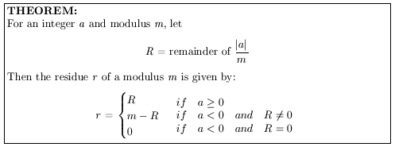
Modular Arithmetic
For a Mod b, divide a by b and take the remainder.
14 ÷ 10 = 1 R 4
14 Mod 10 = 4
24 Mod 10 = 4
Modulus Theorem

Slide 47



Modulus Examples

Slide 48
Modular Inverses
Inverse of 2 is ½ (2 · ½ = 1)
Matrix Inverse: AA⁻¹= I
Modular Inverse for Mod m: (a · a⁻¹) Mod m = 1
For Modular Inverses, a and m must NOT have any prime factors in common

Slide 49
Modular Inverses of Mod 26
A | 1 | 2 | 5 | 7 | 9 | 11 | 15 | 17 | 19 | 21 | 23 | 25
A⁻¹ | 1 | 9 | 21 | 15 | 3 | 19 | 7 | 23 | 11 | 5 | 17 | 25
Example – Find the Modular Inverse of 9 for Mod 26
9 · 3 = 27
27 Mod 26 = 1
3 is the Modular Inverse of 9 Mod 26

Slide 50
Hill Cipher Matrices
One matrix to encrypt, one to decrypt
Must be n x n, invertible matrices
Decryption matrix must be modular inverse of encryption matrix in Mod 26

Slide 51



Modular Inverse Matrices with Example
Calculate determinant of first matrix A, det A
Make sure that det A has a modular inverse for Mod 26
Calculate the adjugate of A, adj A
and Multiply adj A by modular inverse of det A
Calculate Mod 26 of the result to get B

Slide 52
Encryption
Assign each letter in alphabet a number between 0 and 25
Change message into 2 x 1 letter vectors
Change each vector into 2 x 1 numeric vectors
Multiply each numeric vector by encryption matrix
Convert product vectors to letters

Slide 53
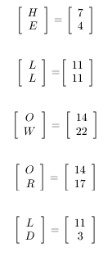
Change Message to Vectors
Message to encrypt = HELLO WORLD
A | B | C | D | E | F | G | H | I | J | K | L | M
0 | 1 | 2 | 3 | 4 | 5 | 6 | 7 | 8 | 9 | 10 | 11 | 12
N | O | P | Q | R | S | T | U | V | W | X | Y | Z
13 | 14 | 15 | 16 | 17 | 18 | 19 | 20 | 21 | 22 | 23 | 24 | 25

Slide 54
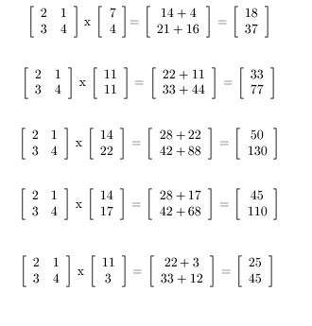
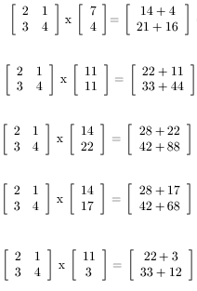
Multiply Matrix by Vectors

Slide 55
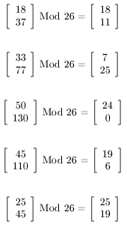
Convert to Mod 26

Slide 56
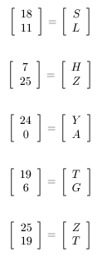
Convert Numbers to Letters
HELLO WORLD has been encrypted to
SLHZY ATGZT

Slide 57
Decryption
Change message into 2 x 1 letter vectors
Change each vector into 2 x 1 numeric vectors
Multiply each numeric vector by decryption matrix
Convert new vectors to letters

Slide 58
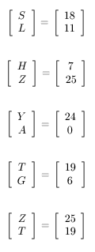
Change Message to Vectors
Message to encrypt = SLHZYATGZT

Slide 59
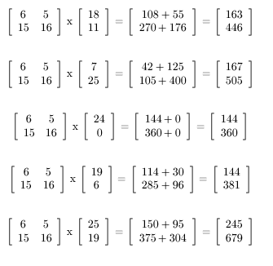
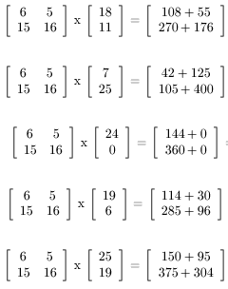
Multiply Matrix by Vectors

Slide 60
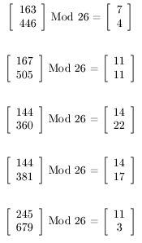
Convert to Mod 26

Slide 61
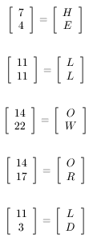
Convert Numbers to Letters
SLHZYATGZT has been decrypted to
HELLO WORLD

Slide 62
Polyalphabetic Ciphers
polyalphabetic substitution ciphers
improve security using multiple cipher alphabets
make cryptanalysis harder with more alphabets to guess and flatter frequency distribution
use a key to select which alphabet is used for each letter of the message
use each alphabet in turn
repeat from start after end of key is reached.
Notes:
One approach to reducing the "spikyness" of natural language text is used the Playfair cipher which encrypts more than one letter at once. We now consider the other alternative, using multiple cipher alphabets in turn. This gives the attacker more work, since many alphabets need to be guessed and because the frequency distribution is more complex, since the same plaintext letter could be replaced by several ciphertext letters, depending on which alphabet is used. The general name for this approach is a polyalphabetic substitution cipher. All these techniques have the following features in common:
A set of related monoalphabetic substitution rules is used.
A key determines which particular rule is chosen for a given transformation.

Slide 63
Vigenère Cipher
simplest polyalphabetic substitution cipher
effectively multiple caesar ciphers
key is multiple letters long K = k₁ k₂ ... k_{d}
i^{th} letter specifies i^{th} alphabet to use
use each alphabet in turn
repeat from start after d letters in message
decryption simply works in reverse
Notes:
The best known, and one of the simplest, such algorithms is referred to as the Vigenère cipher, where the set of related monoalphabetic substitution rules consists of the 26 Caesar ciphers, with shifts of 0 through 25. Each cipher is denoted by a key letter, which is the ciphertext letter that substitutes for the plaintext letter ‘a’, and which are each used in turn, as shown next.

Slide 64
Example of Vigenère Cipher
write the plaintext out
write the keyword repeated above it
use each key letter as a caesar cipher key
encrypt the corresponding plaintext letter
eg using keyword deceptive
key: deceptivedeceptivedeceptive
plaintext: wearediscoveredsaveyourself
ciphertext:ZICVTWQNGRZGVTWAVZHCQYGLMGJ
Notes:
Discuss this simple example from text Stallings section 2.2.

Slide 65
Aids
simple aids can assist with en/decryption
a Saint-Cyr Slide is a simple manual aid
a slide with repeated alphabet
line up plaintext 'A' with key letter, eg 'C'
then read off any mapping for key letter
can bend round into a cipher disk
or expand into a Vigenère Tableau
Notes:
Implementing polyalphabetic ciphers by hand can be very tedious. Various aids were devised to assist the process.
The "Saint-Cyr Slide" was popularised and named by Jean Kerckhoffs, who published a famous early text "La Cryptographie Militaire" (Miltary Cryptography) in 1883. He named the slide after the French National Military Academy where the methods were taught. He also noted that any slide can be expanded into a tableau, or bent round into a cipher disk.
The Vigenère Tableau (given in Stallings 4/e as Table 2.3) is a complete set of forward shifted alphabet mappings.

Slide 66
Security of Vigenère Ciphers
have multiple ciphertext letters for each plaintext letter
hence letter frequencies are obscured
but not totally lost
start with letter frequencies
see if look monoalphabetic or not
if not, then need to determine number of alphabets, since then can attach each
Notes:
The Vigenère & related polyalphabetic ciphers still do not completely obscure the underlying language characteristics. The strength of this cipher is that there are multiple ciphertext letters for each plaintext letter, one for each unique letter of the keyword. Thus, the letter frequency information is obscured. However, not all knowledge of the plaintext structure is lost. The key to breaking them is to identify the number of translation alphabets, and then attack each separately. If a monoalphabetic substitution is used, then the statistical properties of the ciphertext should be the same as that of the language of the plaintext. If, on the other hand, a Vigenère cipher is suspected, then progress depends on determining the length of the keyword.

Slide 67
Kasiski Method
method developed by Babbage / Kasiski
repetitions in ciphertext give clues to period
so find same plaintext an exact period apart
which results in the same ciphertext
of course, could also be random fluke
eg repeated “VTW” in previous example
suggests size of 3 or 9
then attack each monoalphabetic cipher individually using same techniques as before
Notes:
For some centuries the Vigenère cipher was le chiffre indéchiffrable (the unbreakable cipher). As a result of a challenge, it was broken by Charles Babbage (the inventor of the computer) in 1854 but kept secret (possibly because of the Crimean War - not the first time governments have kept advances to themselves!). The method was independently reinvented by a Prussian, Friedrich Kasiski, who published the attack now named after him in 1863. However lack of major advances meant that various polyalphabetic substitution ciphers were used into the 20C. One very famous incident was the breaking of the Zimmermann telegram in WW1 which resulted in the USA entering the war. The important is that if two identical sequences of plaintext letters occur at a distance that is an integer multiple of the keyword length, they will generate identical ciphertext sequences.
In general the approach is to find a number of duplicated sequences, collect all their distances apart, look for common factors, remembering that some will be random flukes and need to be discarded. Now have a series of monoalphabetic ciphers, each with original language letter frequency characteristics. Can attack these in turn to break the cipher.

Slide 68
Autokey Cipher
ideally want a key as long as the message
Vigenère proposed the autokey cipher
with keyword is prefixed to message as key
knowing keyword can recover the first few letters
use these in turn on the rest of the message
but still have frequency characteristics to attack
eg. given key deceptive
key: deceptivewearediscoveredsav
plaintext: wearediscoveredsaveyourself
ciphertext:ZICVTWQNGKZEIIGASXSTSLVVWLA
Notes:
Taking the polyalphabetic idea to the extreme, want as many different translation alphabets as letters in the message being sent. One way of doing this with a smallish key, is to use the Autokey cipher.
The example uses the keyword "DECEPTIVE" prefixed to as much of the message "WEAREDISCOVEREDSAV" as is needed. When deciphering, recover the first 9 letters using the keyword "DECEPTIVE". Then instead of repeating the keyword, start using the recovered letters from the message "WEAREDISC". As recover more letters, have more of key to recover later letters.
Problem is that the same language characteristics are used by the key as the message. ie. a key of 'E' will be used more often than a 'T' etc hence an 'E' encrypted with a key of 'E' occurs with probability (0.1275)2 = 0.01663, about twice as often as a 'T' encrypted with a key of 'T' have to use a larger frequency table, but it exists given sufficient ciphertext this can be broken.

Slide 69
Vernam Cipher
ultimate defense is to use a key as long as the plaintext
with no statistical relationship to it
invented by AT&T engineer Gilbert Vernam in 1918
originally proposed using a very long but eventually repeating key
Notes:
The ultimate defense against such a cryptanalysis is to choose a keyword that is as long as the plaintext and has no statistical relationship to it. Such a system was introduced by an AT&T engineer named Gilbert Vernam in 1918. His system works on binary data (bits0 rather than letters. The system can be expressed succinctly as follows: c_{i} = p_{i} XOR k_{i}
The essence of this technique is the means of construction of the key. Vernam proposed the use of a running loop of tape that eventually repeated the key, so that in fact the system worked with a very long but repeating keyword. Although such a scheme, with a long key, presents formidable cryptanalytic difficulties, it can be broken with sufficient ciphertext, the use of known or probable plaintext sequences, or both.

Slide 70
One-Time Pad
if a truly random key as long as the message is used, the cipher will be secure
called a One-Time pad
is unbreakable since ciphertext bears no statistical relationship to the plaintext
since for any plaintext & any ciphertext there exists a key mapping one to other
can only use the key once though
problems in generation & safe distribution of key
Notes:
The One-Time Pad is an evolution of the Vernham cipher. An Army Signal Corp officer, Joseph Mauborgne, proposed an improvement using a random key that was truly as long as the message, with no repetitions, which thus totally obscures the original message. It produces random output that bears no statistical relationship to the plaintext. Because the ciphertext contains no information whatsoever about the plaintext, there is simply no way to break the code, since any plaintext can be mapped to any ciphertext given some key.
The one-time pad offers complete security but, in practice, has two fundamental difficulties:
There is the practical problem of making large quantities of random keys.
And the problem of key distribution and protection, where for every message to be sent, a key of equal length is needed by both sender and receiver.
Because of these difficulties, the one-time pad is of limited utility, and is useful primarily for low-bandwidth channels requiring very high security. The one-time pad is the only cryptosystem that exhibits what is referred to as perfect secrecy.

Slide 71
Transposition Ciphers
now consider classical transposition or permutation ciphers
these hide the message by rearranging the letter order
without altering the actual letters used
can recognise these since have the same frequency distribution as the original text
Notes:
All the techniques examined so far involve the substitution of a ciphertext symbol for a plaintext symbol. A very different kind of mapping is achieved by performing some sort of permutation on the plaintext letters. This technique is referred to as a transposition cipher, and form the second basic building block of ciphers. The core idea is to rearrange the order of basic units (letters/bytes/bits) without altering their actual values.

Slide 72
Rail Fence cipher
write message letters out diagonally over a number of rows
then read off cipher row by row
eg. write message out as:
m e m a t r h t g p r y
e t e f e t e o a a t
giving ciphertext
MEMATRHTGPRYETEFETEOAAT
Notes:
The simplest such cipher is the rail fence technique, in which the plaintext is written down as a sequence of diagonals and then read off as a sequence of rows.
The example message is: "meet me after the toga party" with a rail fence of depth 2.
This sort of thing would be trivial to cryptanalyze.

Slide 73
Row Transposition Ciphers
is a more complex transposition
write letters of message out in rows over a specified number of columns
then reorder the columns according to some key before reading off the rows
Key: 4312567
Column Out 4 3 1 2 5 6 7
Plaintext: a t t a c k p
o s t p o n e
d u n t i l t
w o a m x y z
Ciphertext: TTNAAPTMTSUOAODWCOIXKNLYPETZ
Notes:
A more complex transposition cipher is to write the message in a rectangle, row by row, and read the message off shuffling the order of the columns in each row. The order of the columns then becomes the key to the algorithm. In the example shown, the key is 4312567, that is use column 4 first, then column3, then 1 etc (as shown in the Column Out row).
A pure transposition cipher is easily recognized because it has the same letter frequencies as the original plaintext. For the type of columnar transposition just shown, cryptanalysis is fairly straightforward and involves laying out the ciphertext in a matrix and playing around with column positions. Digram and trigram frequency tables can be useful.

Slide 74
Product Ciphers
ciphers using substitutions or transpositions are not secure because of language characteristics
hence consider using several ciphers in succession to make harder, but:
two substitutions make a more complex substitution
two transpositions make more complex transposition
but a substitution followed by a transposition makes a new much harder cipher
this is bridge from classical to modern ciphers
Notes:
Have seen that ciphers based on just substitutions or transpositions are not secure, and can be attacked because they do not sufficient obscure the underlying language structure
So consider using several ciphers in succession to make harder.
A substitution followed by a transposition is known as a Product Cipher, and makes a new much more secure cipher, and forms the bridge to modern ciphers.

Slide 75
Rotor Machines
before modern ciphers, rotor machines were most common complex ciphers in use
widely used in WW2
German Enigma, Allied Hagelin, Japanese Purple
implemented a very complex, varying substitution cipher
used a series of cylinders, each giving one substitution, which rotated and changed after each letter was encrypted
with 3 cylinders have 26³=17576 alphabets
Notes:
The next major advance in ciphers required use of mechanical cipher machines which enabled to use of complex varying substitutions.
A rotor machine consists of a set of independently rotating cylinders through which electrical pulses can flow. Each cylinder has 26 input pins and 26 output pins, with internal wiring that connects each input pin to a unique output pin. If we associate each input and output pin with a letter of the alphabet, then a single cylinder defines a monoalphabetic substitution. After each input key is depressed, the cylinder rotates one position, so that the internal connections are shifted accordingly. The power of the rotor machine is in the use of multiple cylinders, in which the output pins of one cylinder are connected to the input pins of the next, and with the cylinders rotating like an “odometer”, leading to a very large number of substitution alphabets being used, eg with 3 cylinders have 26³=17576 alphabets used.
They were extensively used in world war 2, and the history of their use and analysis is one of the great stories from WW2.

Slide 76
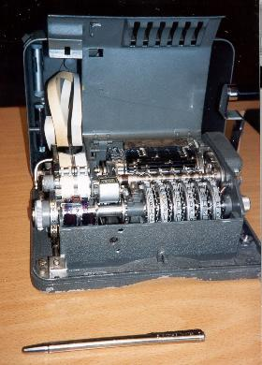
Hagelin Rotor Machine
Notes:
This photo of an Allied Hagelin machine was taken by Lawrie Brown at Eurocrypt'93 in Norway. Note pen for scale, and the rotating cipher wheels near the front.

Slide 77
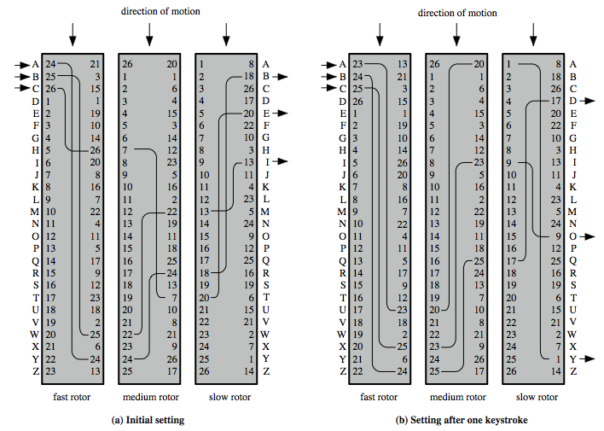
Rotor Machine Principles
Notes:
The basic principle of the rotor machine is illustrated in Figure 2.8. The machine consists of a set of independently rotating cylinders through which electrical pulses can flow. Each cylinder has 26 input pins and 26 output pins, with internal wiring that connects each input pin to a unique output pin. If we associate each input and output pin with a letter of the alphabet, then a single cylinder defines a monoalphabetic substitution. If an operator depresses the key for the letter A, an electric signal is applied to the first pin of the first cylinder and flows through the internal connection to the twenty-fifth output pin. Consider a machine with a single cylinder. After each input key is depressed, the cylinder rotates one position, so that the internal connections are shifted accordingly. Thus, a different monoalphabetic substitution cipher is defined. After 26 letters of plaintext, the cylinder would be back to the initial position. Thus, we have a polyalphabetic substitution algorithm with a period of 26.
A single-cylinder system is trivial and does not present a formidable cryptanalytic task. The power of the rotor machine is in the use of multiple cylinders, in which the output pins of one cylinder are connected to the input pins of the next. Figure 2.8 shows a three-cylinder system. With multiple cylinders, the one closest to the operator input rotates one pin position with each keystroke. The right half of Figure 2.8 shows the system's configuration after a single keystroke. For every complete rotation of the inner cylinder, the middle cylinder rotates one pin position. Finally, for every complete rotation of the middle cylinder, the outer cylinder rotates one pin position. The result is that there are 26 " 26 " 26 = 17,576 different substitution alphabets used before the system repeats.

Slide 78
Steganography
an alternative to encryption
hides existence of message
using only a subset of letters/words in a longer message marked in some way
using invisible ink
hiding in LSB in graphic image or sound file
has drawbacks
high overhead to hide relatively few info bits
advantage is can obscure encryption use
Notes:
Steganography is an alternative to encryption which hides the very existence of a message by some means. There are a large range of techniques for doing this.
Steganography has a number of drawbacks when compared to encryption. It requires a lot of overhead to hide a relatively few bits of information.
Also, once the system is discovered, it becomes virtually worthless, although a message can be first encrypted and then hidden using steganography. The advantage of steganography is that it can be employed by parties who have something to lose should the fact of their secret communication (not necessarily the content) be discovered.

Slide 79
Cryptographic Algorithms and Protocols
Four main areas:
Symmetric encryption: Used to conceal the contents of blocks or streams of data of any size, including messages, files, encryption keys, and passwords.
Asymmetric encryption: Used to conceal small blocks of data, such as encryption keys and hash function values, which are used in digital signatures.
Data integrity algorithms: Used to protect blocks of data, such as messages, from alteration.
Authentication protocols: These are schemes based on the use of cryptographic algorithms designed to authenticate the identity of entities.

Slide 80
Classical Cryptography: Secret-Key or Symmetric Cryptography
A and B agree on an encryption method and a shared key.
A uses the key and the encryption method to encrypt (or encipher) a message and sends it to B.
B uses the same key and the related decryption method to decrypt (or decipher) the message.

Slide 81
Advantages of Classical Cryptography
There are some very fast classical encryption (and decryption) algorithms
Since the speed of a method varies with the length of the key, faster algorithms allow one to use longer key values.
Larger key values make it harder to guess the key value -- and break the code -- by brute force.

Slide 82
Disadvantages of Classical Cryptography
Requires secure transmission of key value
Requires a separate key for each group of people that wishes to exchange encrypted messages (readable by any group member)
For example, to have a separate key for each pair of people, 100 people would need 4950 different keys.

